Slide 1
Palletforce &
[Customer Name]
Partnership Presentation
11th April 2022

Slide 2



Operating Board
KATE LOVATT
IT Director

Slide 3
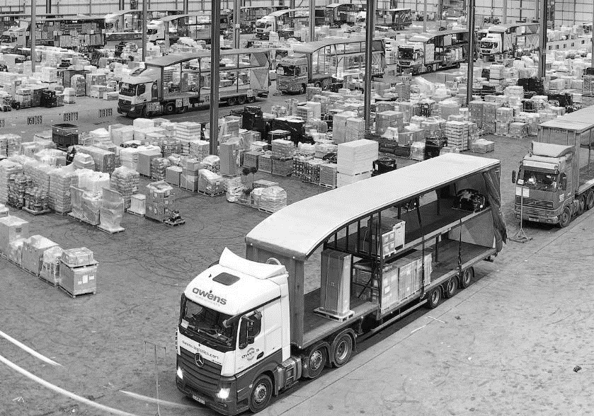






Market Leaders For 20 Years
Palletforce was formed in 2001, with 36 founding members and handled just over 500 pallets on its first night.
Today we have a multi award-winning network of 120 members, operating from 150 UK depots, collecting and delivering to every UK postcode every day.

Slide 4
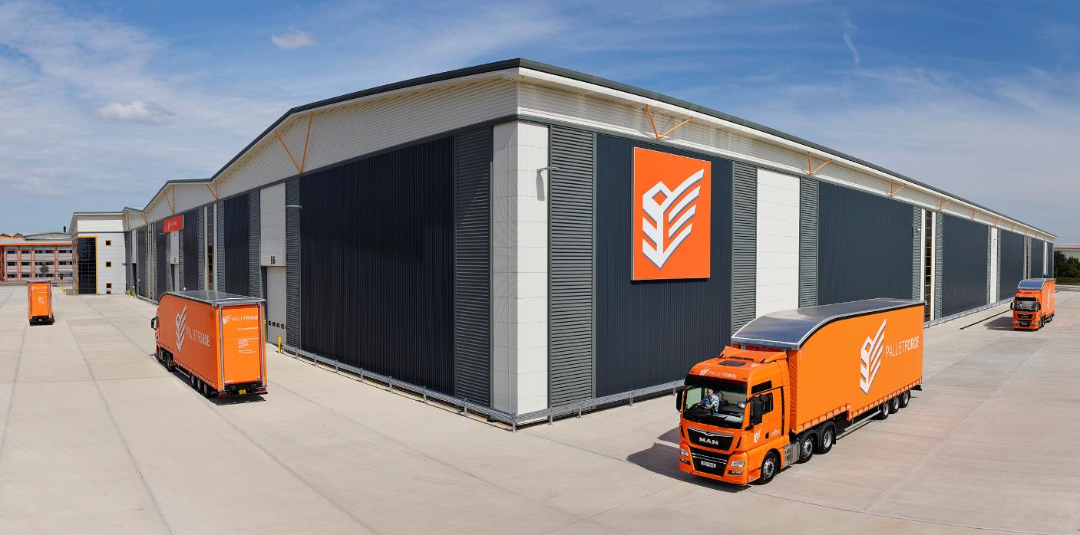
Where Are We Now?
The SuperHub
£65m investment
38 acre site
620,000 sq ft
30k pallets daily capacity
450 trunks nightly
500 parking spaces
Europe’s largest drive
through facility

Slide 5

Palletforce At A Glance
120 member companies
150 UK depots
Over 25 countries
50 million pallets delivered
4,000 delivery vehicles
620,000 sq ft SuperHub

Slide 6
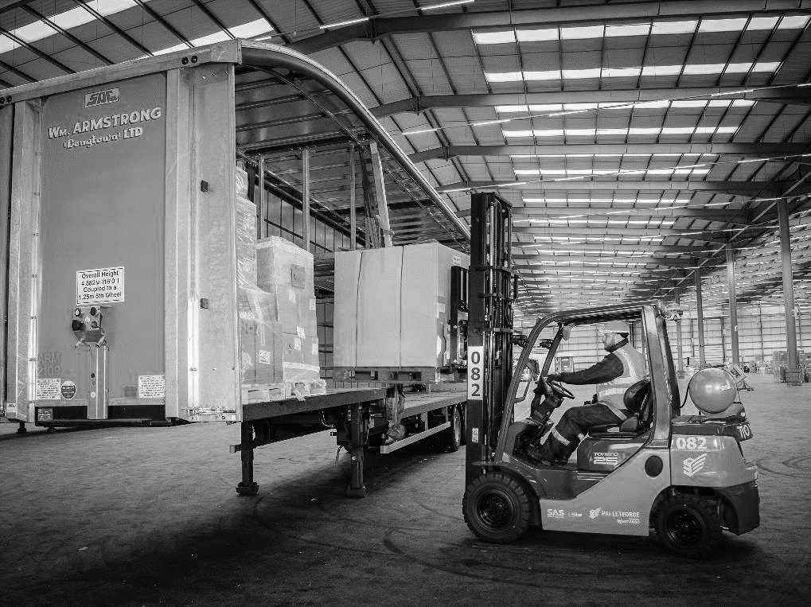
Services We Offer
Next day and economy options
Direct inject - corporate accounts
Before 10am
AM delivery
Saturday delivery
Timed deliveries
Tail-lift deliveries
Amazon consolidation
European and international

Slide 7
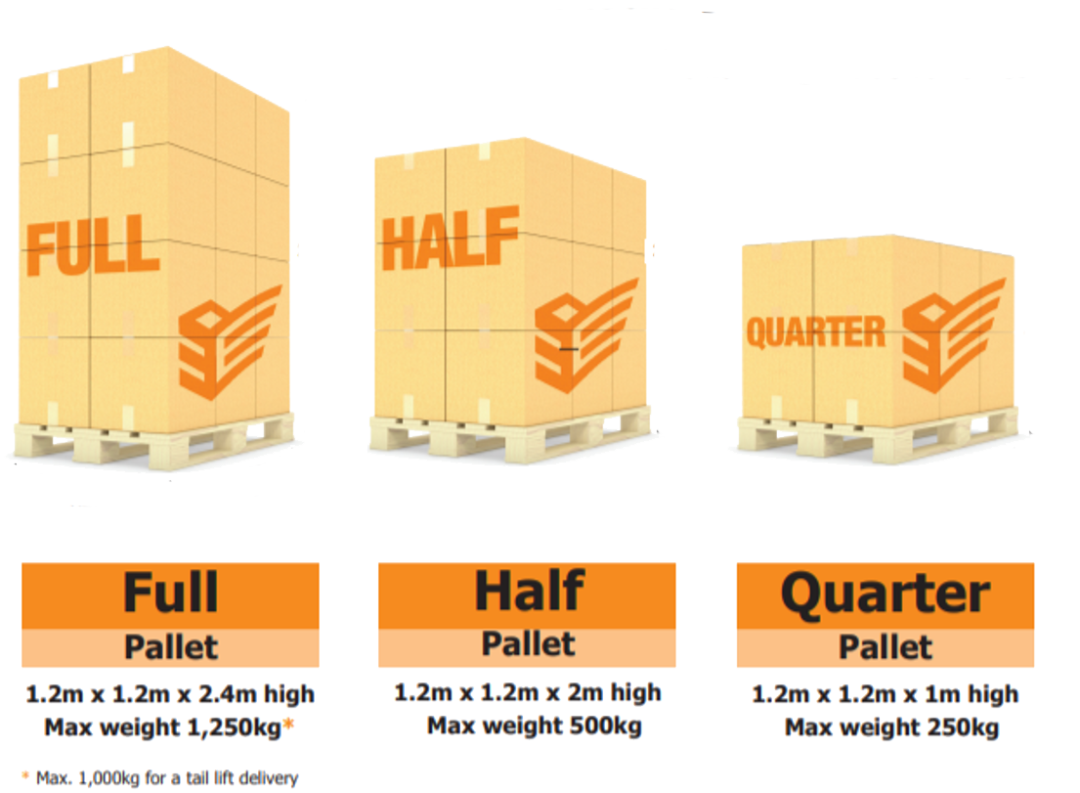
Pallet Dimensions
Palletforce offers generous full, half and quarter pallet dimensions and weights.
Our options are the most competitive in the sector.
Ability to cost-effectively handle consignments of all sizes.

Slide 8
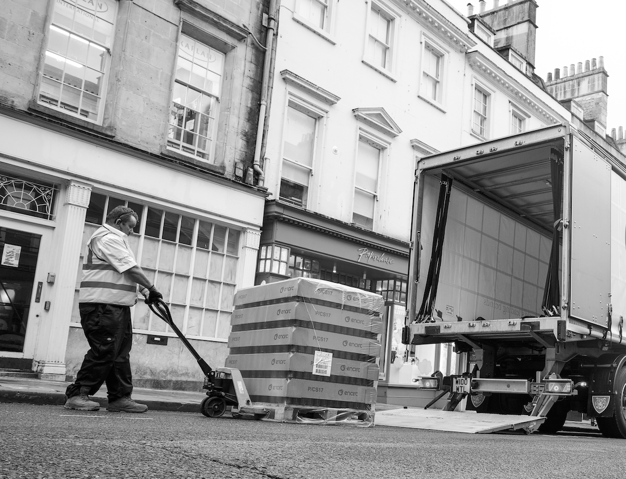
Tail-lift Deliveries
We offer tail-lift deliveries which are kerbside only and will be made using a pallet truck to lift and move the pallet.
We can only unload on hard, even ground.
The pallet truck can’t operate on gravel, stones, grass, kerbs or steps.
The maximum weights for tail-lift deliveries are 1,000kg for a standard delivery vehicle and 750kg for a 7.5-tonne vehicle.

Slide 9
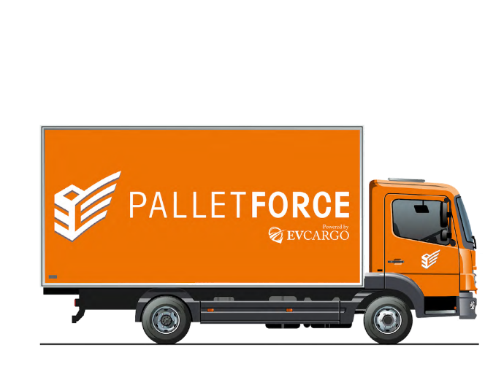

Delivery Vehicles
In line with our health and safety procedures, Palletforce offers a kerbside delivery service only.
The delivery driver is required to carry out a dynamic risk assessment for each individual delivery location and will make decisions considering site conditions and safety.
18-tonne delivery vehicle
7.5-tonne delivery vehicle
4m
4m
11m
7.8m

Slide 10
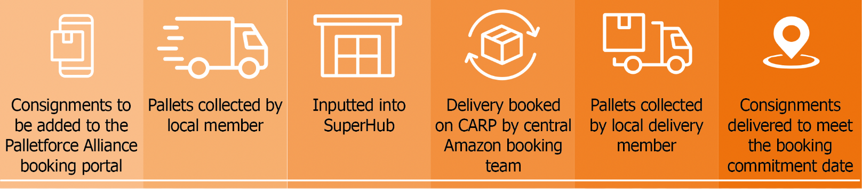
Delivering To Amazon
Palletforce manages Amazon bookings centrally.
We book deliveries into CARP on your behalf.
We can provide info to help dispute any charge-backs.

Slide 11

Gateway To Europe
We connect international trade by providing distribution services throughout Europe
and into Asia.
Palletforce and its Members operate in 20+ countries.
Cost competitive customs clearance, import and export formalities.

Slide 12
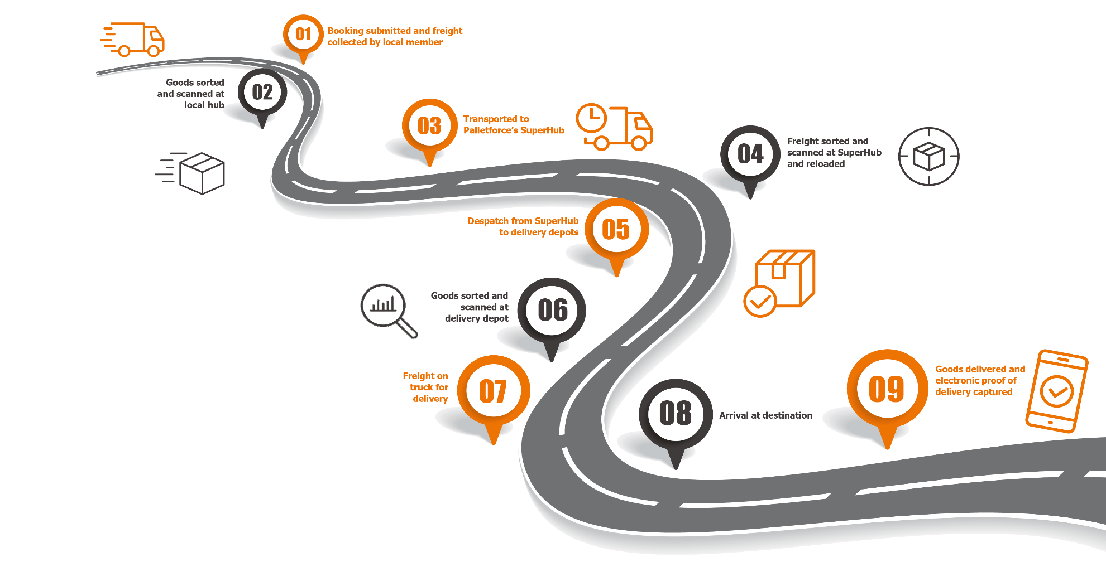
The Palletforce distribution process

Slide 13

Sustainable Distribution
As a signatory to the UN Global Compact, Palletforce is driven by its core company value of sustainability.
Our operating model ensures trucks run fully loaded for as long as possible, reducing fuel and emissions.
We achieve much higher levels of trailer fill than other logistics sectors.
Our technology highlights delivery issues and reduces miles associated with re-deliveries.
SuperHub utilises rain-water harvesting, LED lighting and electric vehicle charging.

Slide 14










Corporate Account Portfolio

Slide 15

Award Winning Technology
Our vision: We will transform logistics into a technology industry.

Slide 16

Alliance Online IT System
In-house system, continually developing, which handles the entire pallet lifecycle and integrates seamlessly with customer systems.
Real time with inter-depot communication.
Improves security and efficiency throughout the network.
Live track and trace for customers and consignees.
Paperless – customer PODs scanned digitally.
Automatic customer manifest creation.
Offers customers control of their bookings.
Complete web-based system.

Slide 17
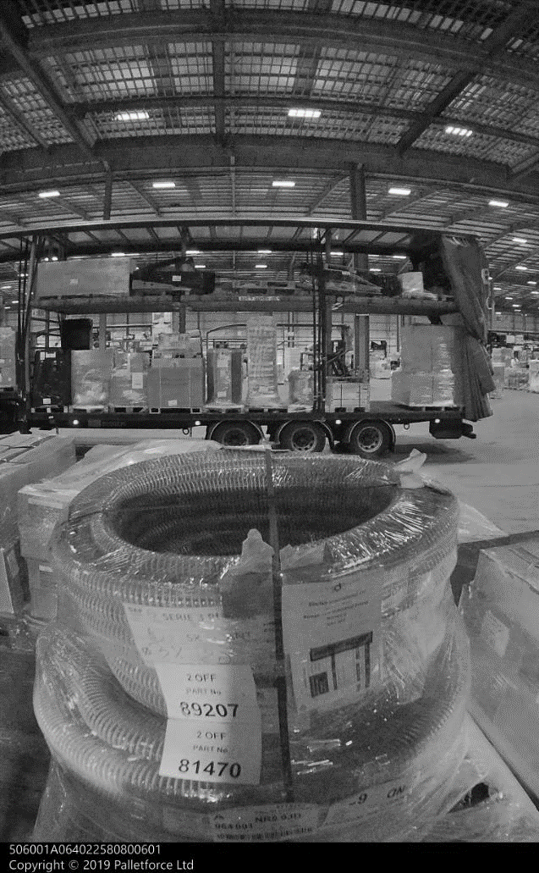
Technology Trident
Alliance Sense
The only network offering Artificial Intelligence, analysing data from 100,000 tracking events daily to predict potential delivery issues before they happen.
Pallet Selfies
Live imaging of every pallet as it passes through to SuperHub, combined with instant weighing using patented technology to deliver unrivalled freight visibility.
ePOD
Contactless and paperless delivery, powering live tracking and providing a wide range of delivery notifications.

Slide 18

Super FLTs
Exclusive to Palletforce and equipped with unique and patented technology.
Every pallet is weight, scanned, tracked and photographed on unloading and loading.
Customers benefit from real-time visibility, hub tracking and accurate weights – visible in Alliance.
Maximise efficiency and safety as they inform the driver the optimal way to load the trailer.

Slide 19
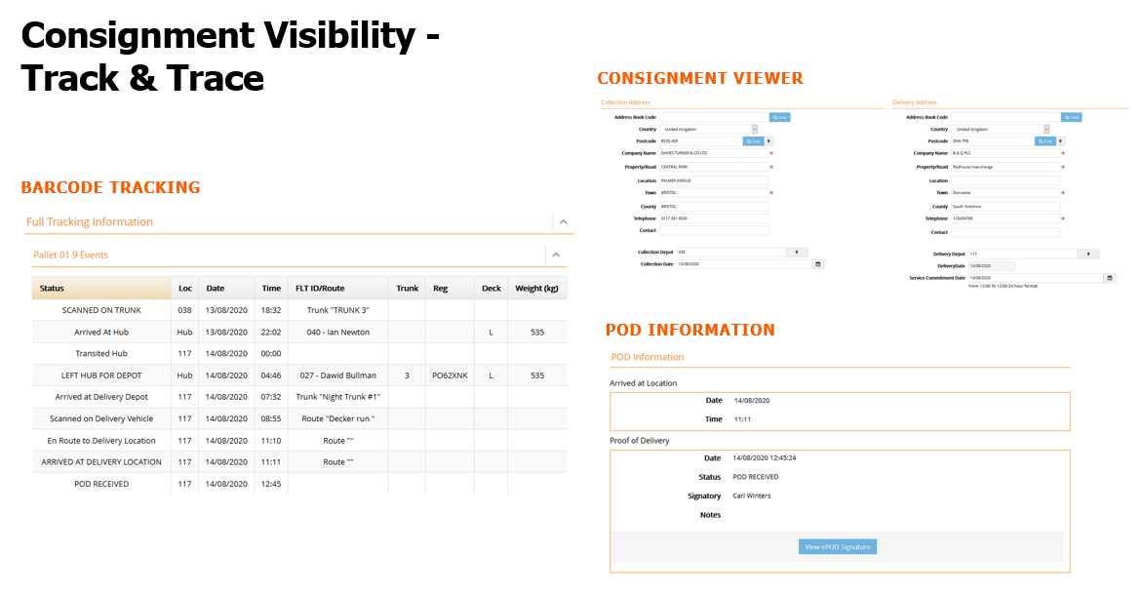
Consignment Visibility
Track & Trace

Slide 20
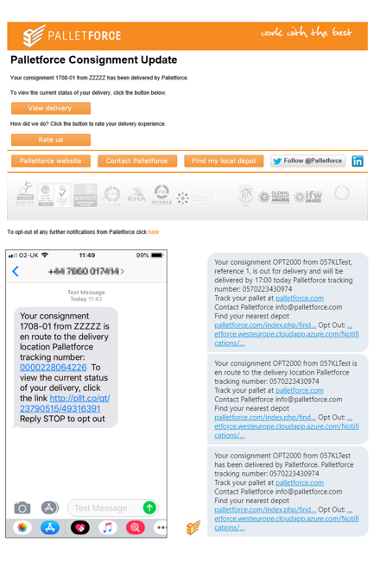
Consignment Notifications
Notifications are available at every stage, including:
Spotlight reports on Alliance.
Damage scans provide notes against consignments.
Trunking alerts and management.
Real time event driven alerts, available via SMS, Twitter, App and Alliance:
Arrival at the SuperHub.
Scanned to delivery vehicle.
En route to location.
Delivered and proof of delivery.

Slide 21
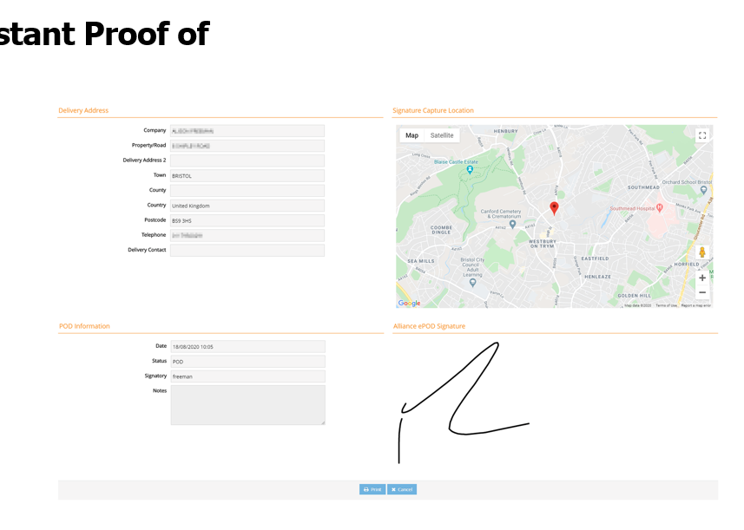
ePOD – Instant POD

Slide 22
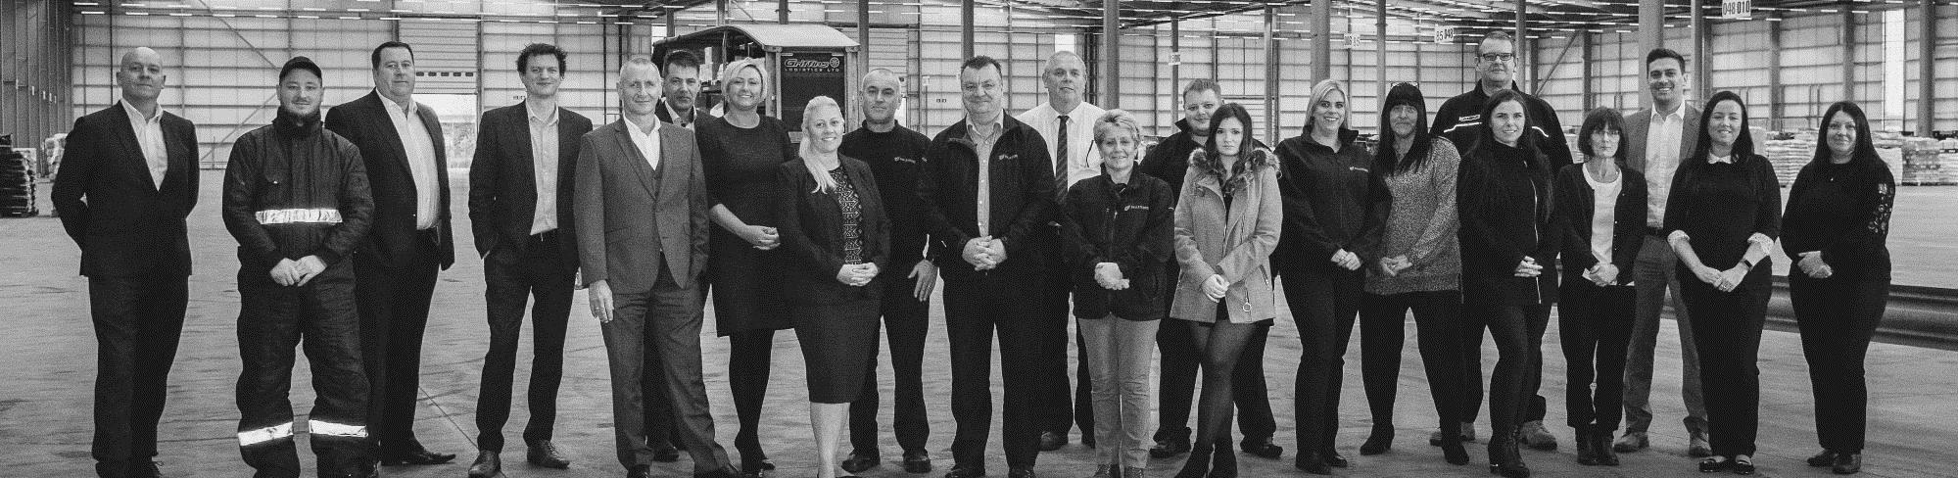
The Network Team
Enabling a strong bond between the network and its members, offering our customers confidence that any potential operational issues are identified and resolved.
Supporting depots to successfully and consistently grow their input through fantastic performance and service, managing the risk and capacity of members, maintaining strong communication, auditing and managing member performance regularly.

Slide 23






EV Cargo
EV Cargo is a technology-enabled supply chain management and logistics execution platform, which manages supply chains for the world’s leading brands.
>295,000 TEU of sea freight
>55m Kg of air freight
Global logistics provider with over 3,000 customers and £1.2 billion revenue.
Regional hubs in Dubai, Hong Kong, London and Singapore.
Offices in 24 countries with operations in over 150.
Operating segments: air & sea freight, road freight and contract logistics along with associated technology services.
End-to-end solutions enable the secure and sustainable international movement of goods, data and funds.
>500k loads of FTL road freight
>20,000 operatives use our software
>2,300 supply chain professionals
>3.9m orders managed

Slide 24
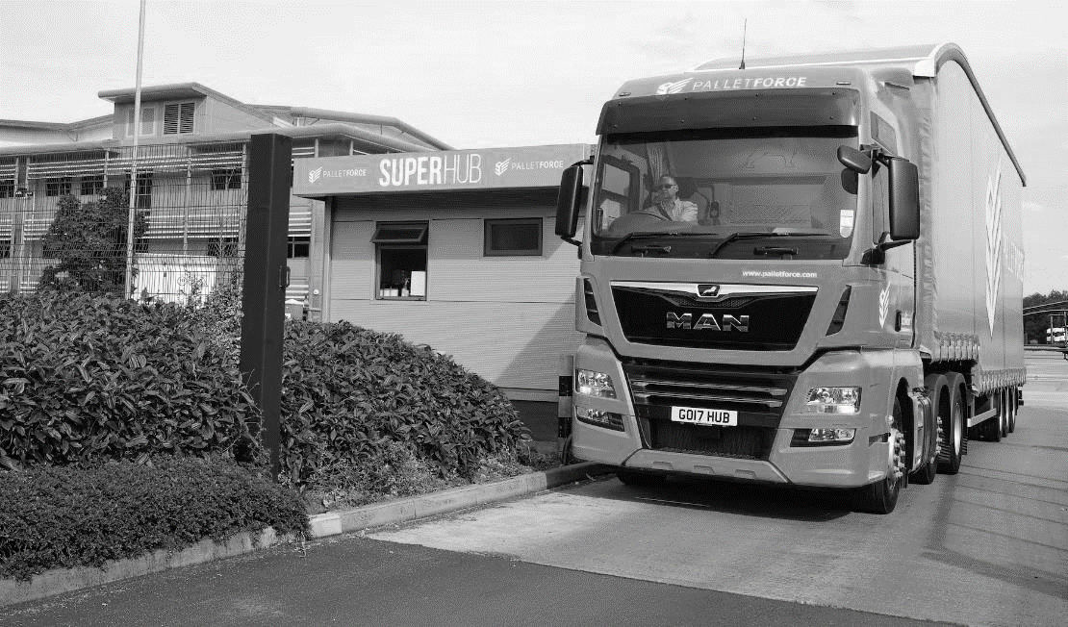



Contact
Palletforce Commercial Team
info@Palletforce.com
01283 539392
Palletforce SuperHub,
Callister Way
Centrum West
Burton upon Trent
DE14 2SY
Palletforce.com

Slide 25
Contact
Simon Bradbury
Sales Director
Simon.Bradbury@Palletforce.com
07867 977122
Palletforce SuperHub,
Callister Way
Centrum West
Burton upon Trent
DE14 2SY
Palletforce.com

Slide 26
Contact
Emma Thompson
Commercial Development Manager - Midlands
Emma.Thompson@Palletforce.com
07912 598668
Palletforce SuperHub,
Callister Way
Centrum West
Burton upon Trent
DE14 2SY
Palletforce.com

Slide 27
Contact
Luke Nixon
Commercial Development Manager - North
Luke.Nixon@Palletforce.com
07958 324895
Palletforce SuperHub,
Callister Way
Centrum West
Burton upon Trent
DE14 2SY
Palletforce.com

Slide 28
Contact
Jon Norris
Commercial Development Manager - South
Jon.Norris@Palletforce.com
07522 551189
Palletforce SuperHub,
Callister Way
Centrum West
Burton upon Trent
DE14 2SY
Palletforce.com

Slide 29
Contact
Sue Wheatley
Sales Admin
Sue.Wheatley@Palletforce.com
01283 741769
Palletforce SuperHub,
Callister Way
Centrum West
Burton upon Trent
DE14 2SY
Palletforce.com

